Slide 1
QUALYS DEMO – SECURITY HARDENING II
Lets have a detailed look at Qualys interface for Policy Compliance

Slide 2
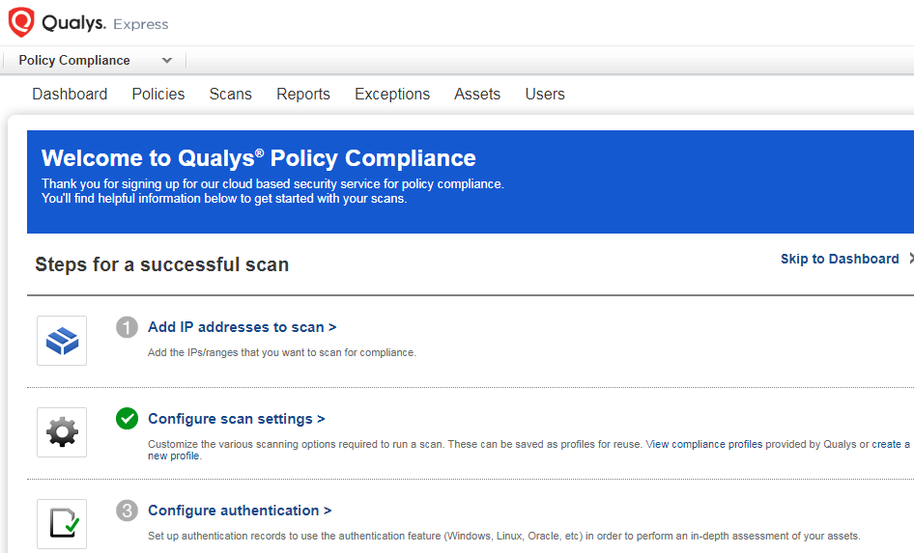
QUALYS DEMO – SECURITY HARDENING II
1. ADD IP ADDRESSES TO SCAN

Slide 3
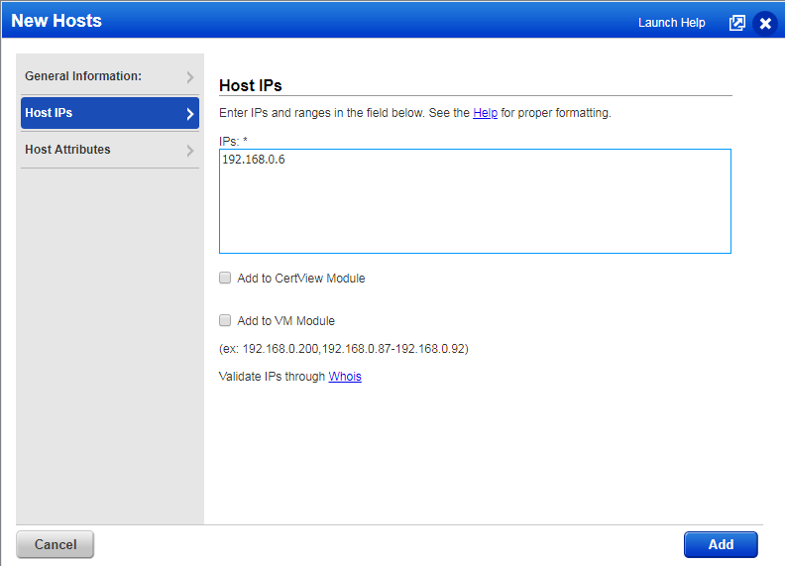
QUALYS DEMO – SECURITY HARDENING
1. ADD IP ADDRESSES TO SCAN

Slide 4
QUALYS DEMO – SECURITY HARDENING
2. CONFIGURE SCAN SETTINGS

Slide 5
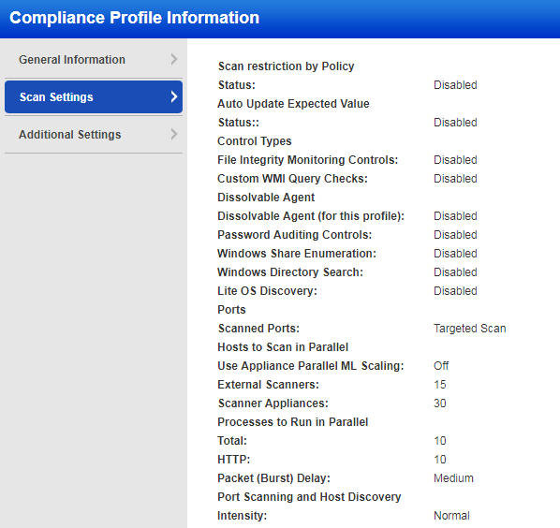
QUALYS DEMO – SECURITY HARDENING
2. CONFIGURE SCAN SETTINGS

Slide 6
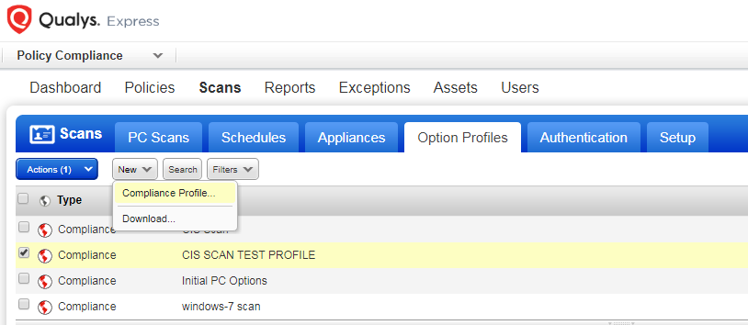
QUALYS DEMO – SECURITY HARDENING
NEW COMPLIANCE PROFILE

Slide 7
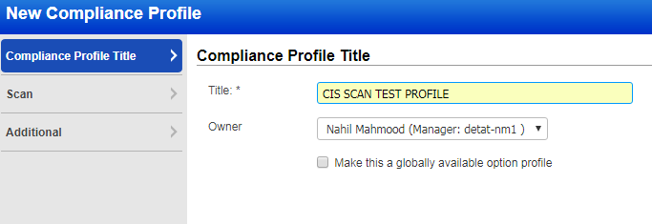
QUALYS DEMO – SECURITY HARDENING
‘CIS SCAN TEST PROFILE’ CREATED

Slide 8
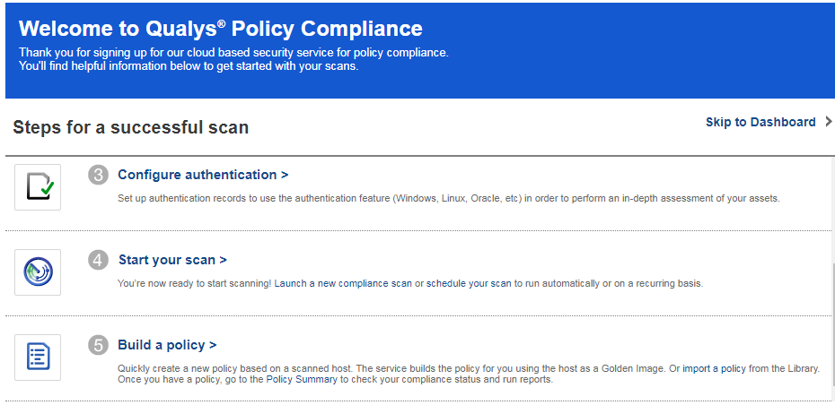
QUALYS DEMO – SECURITY HARDENING
3. CONFIGURE AUTHENTICATION

Slide 9
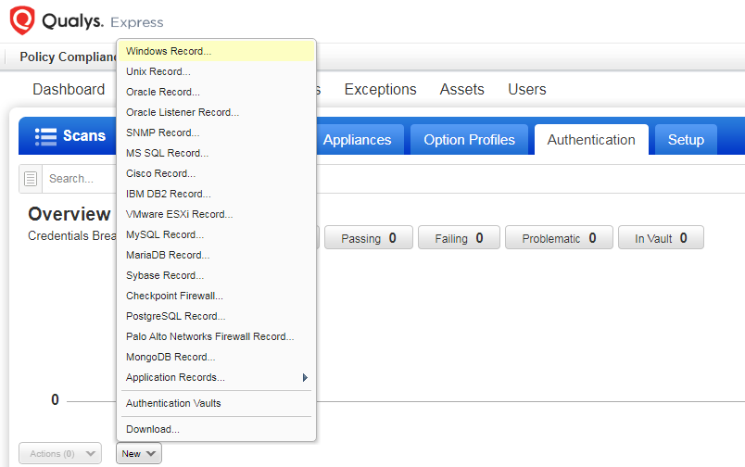
QUALYS DEMO – SECURITY HARDENING

Slide 10
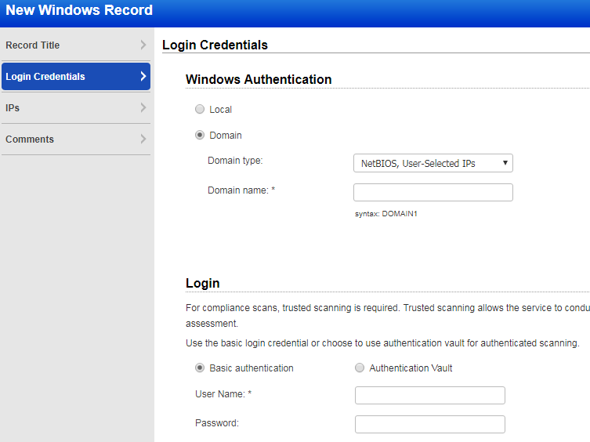
QUALYS DEMO – SECURITY HARDENING
3. CONFIGURE AUTHENTICATION

Slide 11
QUALYS DEMO – SECURITY HARDENING
3. CONFIGURE AUTHENTICATION

Slide 12
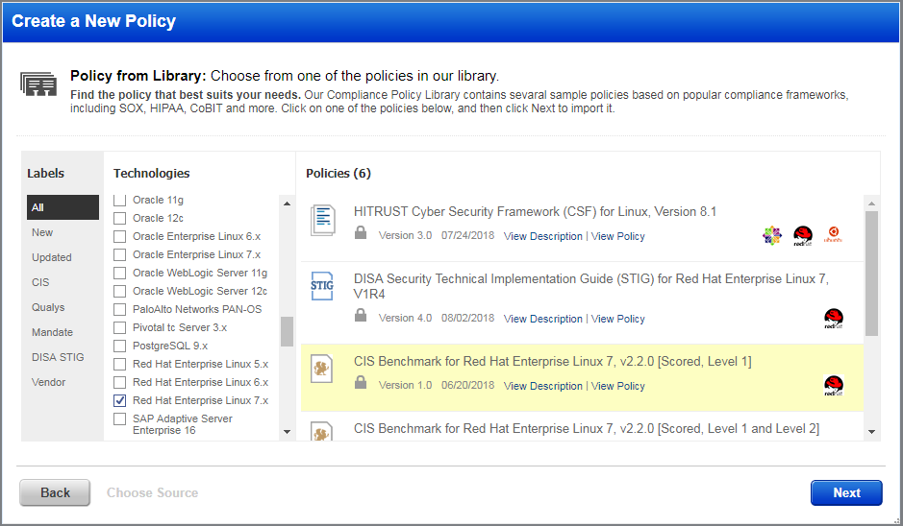
QUALYS DEMO – SECURITY HARDENING
3. CONFIGURE AUTHENTICATION
COMPLIANCE LIBRARY: CIS RED HAT ENT. LINUX 7

Slide 13
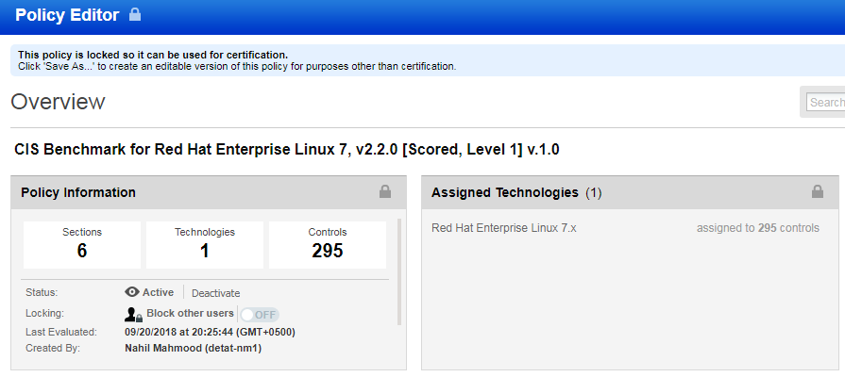
QUALYS DEMO – SECURITY HARDENING
POLICY EDITOR

Slide 14
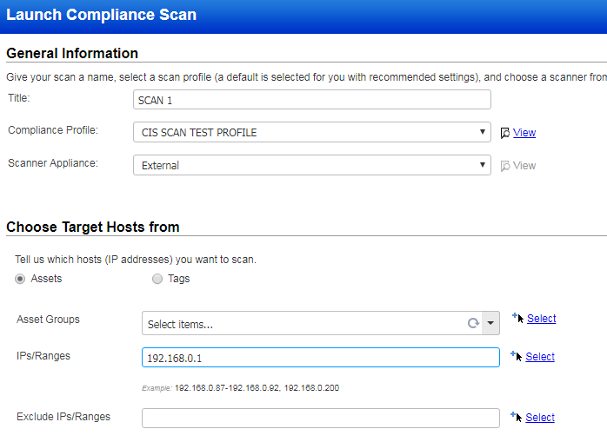
QUALYS DEMO – SECURITY HARDENING
POLICY EDITOR
LAUNCH COMPLIANCE SCAN

Slide 15
QUALYS DEMO – SECURITY HARDENING II
The scan features may also be adjusted from the main Qualys dashboard
END

